Slide 1
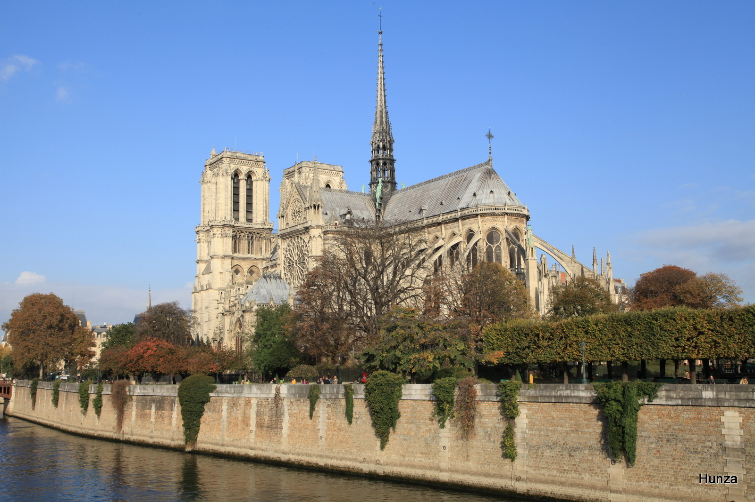
Paradoxical oncologic results of Gardasil in real life. A cancer registers study
Dr G Delépine surgeon oncologist
N Delépine pediatrician oncologist
Paris, France
nicole.delepine@bbox.fr gerard.delepine@bbox.fr
Authors have no competing interest

Slide 2
Why such a study about Gardasil
A huge propaganda over the world leads families to vaccine their girls and now boys and feel guilty to hesitate
as many complications are already known and don’t stop the vaccine hysteria
if market is an evident cause, we decide to explore the true results of a 12Y campaign on the goal : decrease of cervix cancer in vaccinated population
we would like to know the true facts and evoke first the Gardasil legend

Slide 3
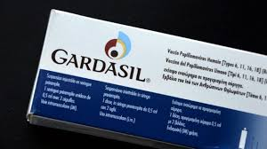
The golden fake tale of Gardasil
1°) Cervix cancer represents a major threat for women
2°) HPV cancers are due only to some HPV
4°) Clinical trials demonstrate that vaccine are very activ without side effects
5°) Vaccine will eradicate HPV related cancers
« Gitf from god to women »

Slide 4
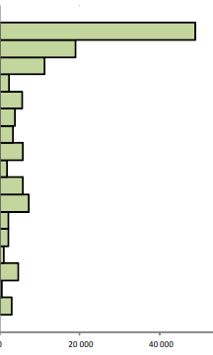
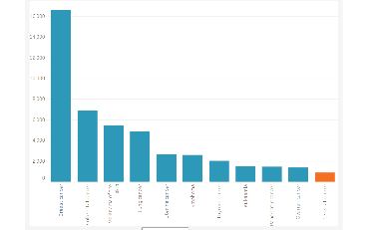
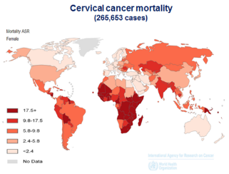
First lie : Cervix cancer represents a major threat for women in western countries
Incidence France
Less than 1% cancers and 0,6% of mortality from cancer in US, France, UK, Australia, Canada
Mostly preventable deaths with pap screening
Most women (70%) who die of cervix cancer do not follow screening recommandations
Incidence Australia
Cervix cancer represents a very minor threat in countries with pap smear

Slide 5
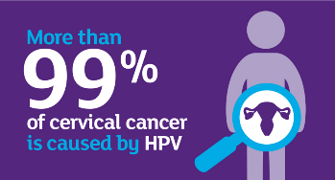
Second lie : « virus are the unique cause of cervix cancer »
According to these misleading affirmations 99% of cervix cancers would be caused by HPV virus
The discrepancy currently observed between a sharp decrease in HPV infections as a result of HPV vaccines and the sharp increase in the incidence of invasive cancers among the most vaccinated age groups, militates against a direct causal link

Slide 6
3rd lie: trials have shown that vaccines are effective against cancer without risk
13 years after marketing authorization
efficacy is demonstrated only against infection of some strains of HPV for a duration of 5 to 8 years and some benign lesions
No study shows efficacy against invasive cancer!
Infection is not cancer
A lot of severe side effects already published including severe neurologic syndroms and deaths

Slide 7
Etiology of cancer is multifactorial !
early age at first intercourse sexual activity
number of sexual partners
infection (chlamydia or viruses HPV, Herpes)
parity
immune deficiencies
duration of use of oral contraceptives
smoking status
All these factors are statislically correlated resulting in confounding bias
Only very large multifactorial analyzes could precise the real weights of each factor

Slide 8
Gardasil demonstrates its effect on HPV infection, but:
we have studied the effect on cervix cancer
important to keep in mind that infection is not cancer

Slide 9
Aims and criteria to evaluate oncologic results of HPV vaccination
on trends of incidence* of invasive cervical cancer
in countries
with high HPV vaccine coverage
sound national cancer registers
to compare these to the trend in France
country with low anti HPV vaccine coverage
*Incidence = new cases number /year/ per 100,000 women

Slide 10
Method 1
Collection of crude* and standardized** incidence of invasive cervix cancer
from oncologic registers
Australia (Australian Institute of Health and Welfare ACIM )
Great Britain (National Office of Statistics and Cancer research UK)
Sweden and Norway (Nordcan)

Slide 11
DEFINITIONS
Crude incidence: simplest method for comparing cases
For a specific tumor and population, a crude rate is calculated simply by dividing the number of new cancers or cancer deaths observed during a given time period by the corresponding number of person years in the population at risk. For cancer, the result is usually expressed as an annual rate per 100,000 persons at risk.
As cancer is more common in the elderly, crude rates are influenced by the proportions of older people in the population. Crude rate is appropriate to compare a precise age group at different period but comparisons between 2 areas/time periods with different population profiles are misleading
Age-standardized rates (ASR)
ASR is a summary measure of the rate that a population would have if it had a standard age structure. The ASR is a weighted mean of the age-specific rates; the weights are taken from population distribution of the standard population. The most frequently used standard population is the World Standard Population. It is also expressed per 100000. identify real differences between populations not linked to ageASR (age-standardised rate)

Slide 12
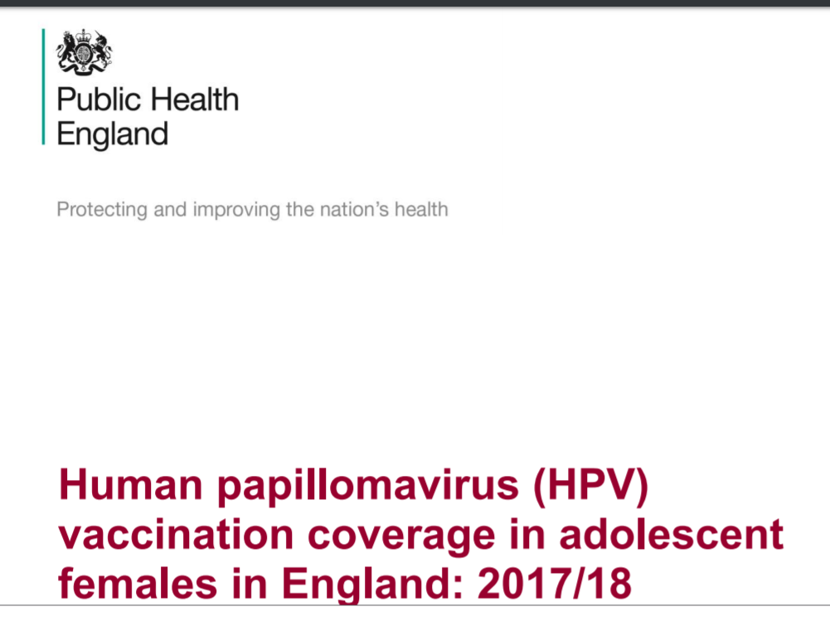
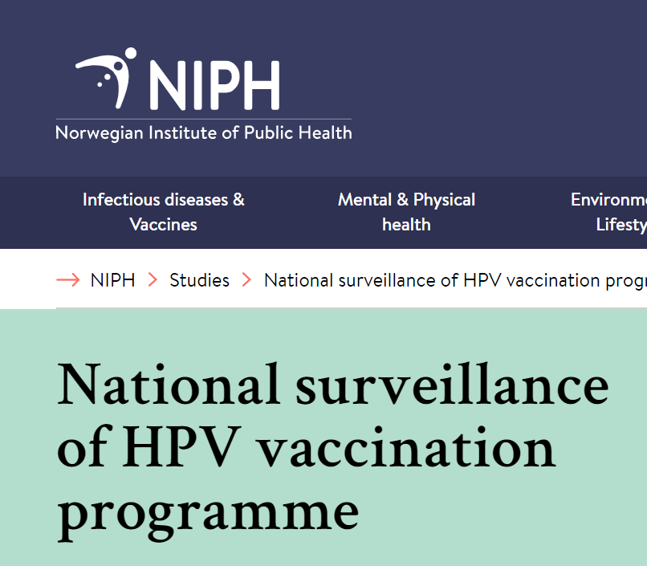
Method 2
Collection of vaccine coverage rate for the different age groups
from public health authorities
-20-24 : higher vaccine coverage
25-34 : many catch-up vaccinated
after 50 : unvaccinated

Slide 13
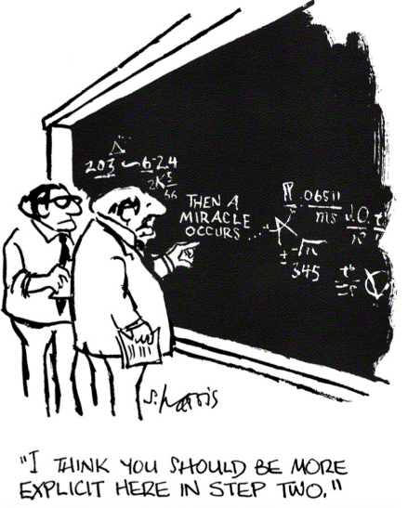
Method : statistical analysis
Statistical analyze of the evolutions and the trends
in the global populations in these different countries (on world standardized incidence)
before and after the era of vaccination
and in the different age groups (on crude incidence of each particular age group)
with a particular attention to 20-29 age groups (highest vaccine coverage)

Slide 14
Method : trend affirmation
To test the reality of trends we use Pearson's correlation coefficient between years and incidences.
As usual we fixed the probability of alpha risk (defined as the risk of rejecting the null hypothesis when in fact it is true) p value to 0,05

Slide 15
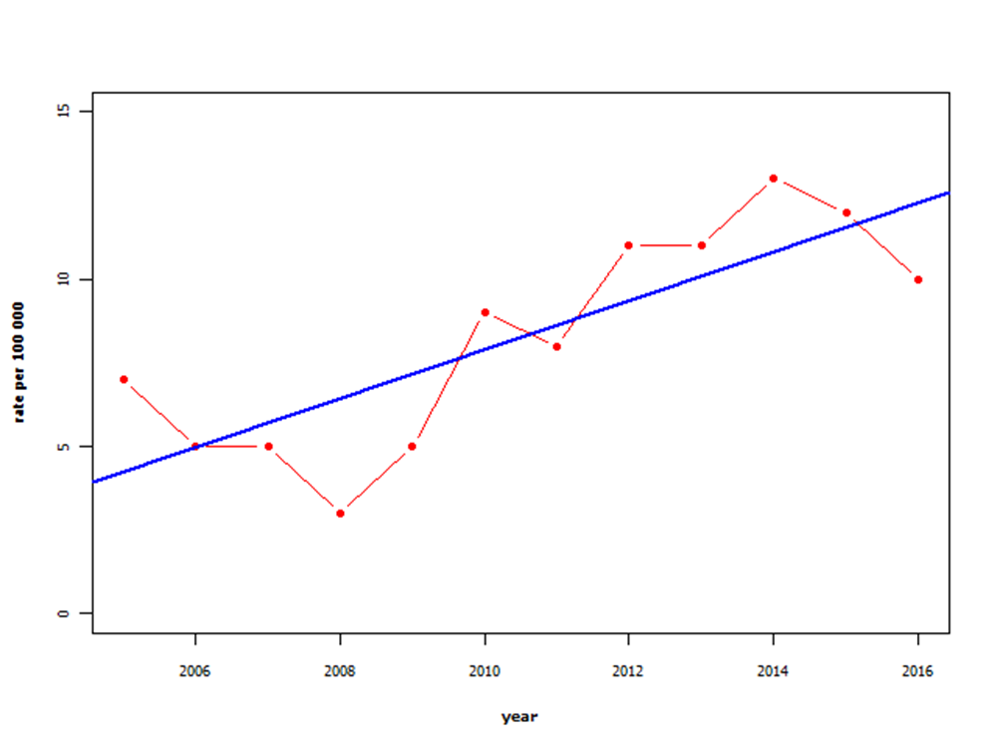
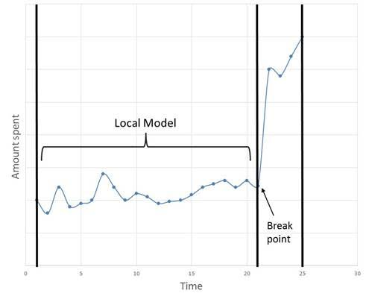
Method : searching break points
To determine the eventual year of significant modification in trends we watch to break point analysis.
This method is mostly use in financial reports
The break-even point (BEP) is, the point at which a significant change in incidence trends appears
That permit to establish a eventual time correlation between vaccine and incidence increasing
Increase without break out point

Slide 16
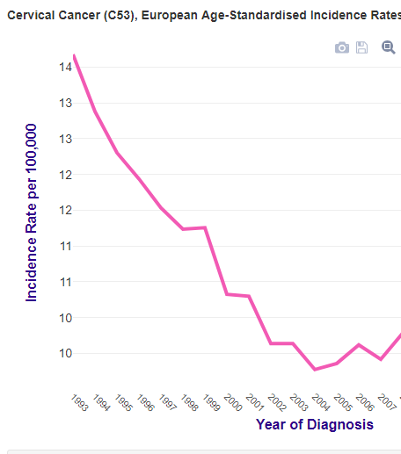
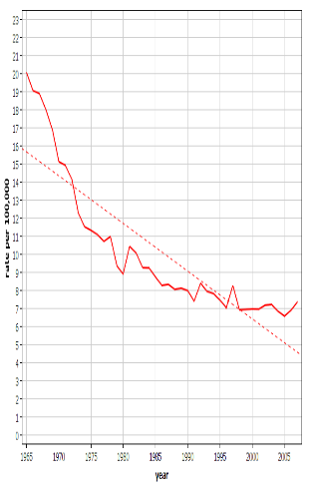
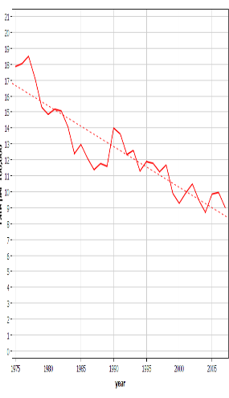
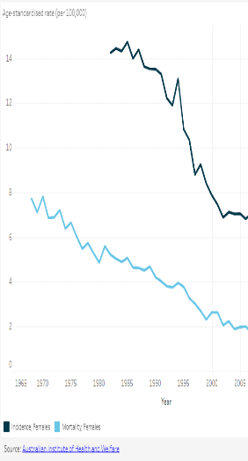
Results: Pre vaccination period
During the 1989-2007 period, the incidence of invasive cervical cancer declined in all countries with pap screening
United Kingdom
Sweden
Norway
These impressive advances are due to pap screening
Australia

Slide 17
vaccine era start
2007 Australia
2008 Great Britain
2010 Sweden and Norway
Since vaccination in all countries with high immunization coverage :
follow up 6-7 y
cancer registers >> increase in the incidence of invasive cervical cancer
appears after the vaccination campaign start
affects almost exclusively the most vaccinated age groups

Slide 18
First 5 y after vaccine for 20-29
In Great Britain women aged 16-18 in 2008 (when vaccinated) reached 20-22 in 2012
Australian women vaccinated when they were 13-26 in 2007 where 18-31 in 2012
In France (less than 20% vaccine coverage) : decreasing incidence
Age-specific incidence used to show incidence trends with time by age groups to compare the evolution of vaccinated versus unvaccinated groups

Slide 19
(September 2018 report)
Vaccine in England
Vaccine in Australia
France

Slide 20
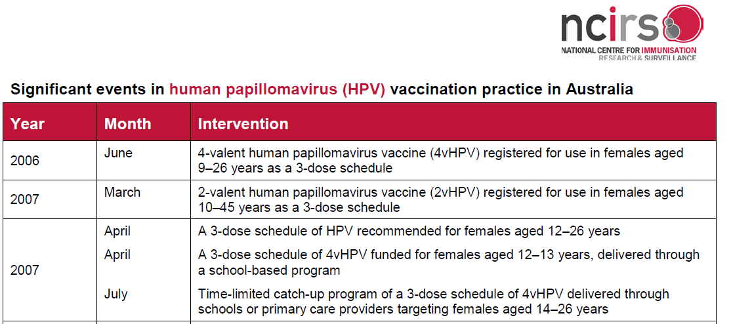
AustraliaN vaccination program
Vaccination campaign started in April 2007 for girls aged 12-13 years(19-20 in 2014)
catch up program for 14 to 26 year females (21 to 33 in 2014)

Slide 21
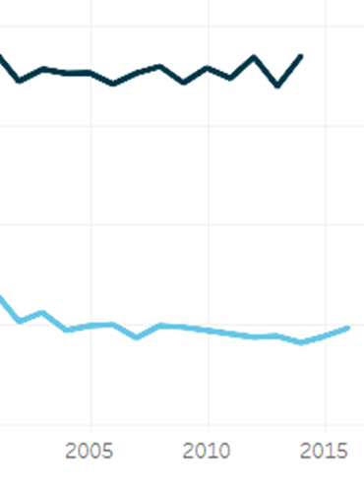
Australia Global trend of incidence : No more advance since vaccination
vaccination
7,4
6,8
AIHW 2017. Cancer in Australia 2017. Cancer series no. 101. Cat. No. CAN 100. Canberra: AIHW.

Slide 22
for 20-24 girls (13-17 in 2007) Incidence of invasive cervix cancer increased by 50%
The very low incidence of cervix cancer in this age group explains that this increase is not statistically significant

Slide 23
Increase of incidence after « catch up » vaccine
(14-26 y in 2007, 22-34 in 2015)
12,3
30-34 y : 25% P<0,01
9,9
8
25-29 y : 35%
5,9
In the 30-34 age group ( high % of catch up vaccinated) the increase is statistically signifiant

Slide 24
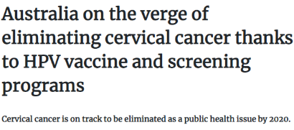
Australian propaganda lies based on biaised predictions and simulation
Facts from official register (ACIM)
In 2006, 728 new cases of cervical cancer diagnosed and 201 deaths
In 2018, it is estimated that 930 new cases of cervical cancer will be diagnosed and that 258 women will died from cervix cancer

Slide 25
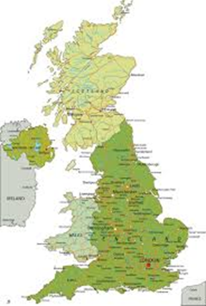
Great-Britain
National Vaccination program
introduced in 2008 to offer HPV vaccination routinely to 12–13-years
+ catch-up vaccination to girls up to 18 years,
HPV vaccination coverage in England is high with more than 80% of 12–13-y old receiving the full course
Coverage within the catch-up cohorts is lower (ranging from 39% to 76%).

Slide 26
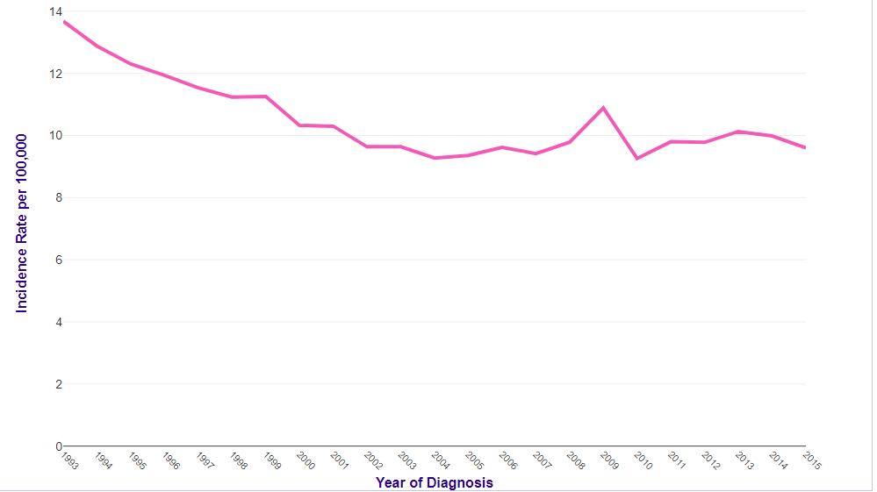
UK: global trend national cancer register
14
9,6
9,4
vaccination
Since the vaccination the standardized incidence overall population stabilized from 9.4 per 100000 in 2007 to 9.6 in 2015
with contrasting trends between the age groups
Based on a graphic created by Cancer Research UK.

Slide 27
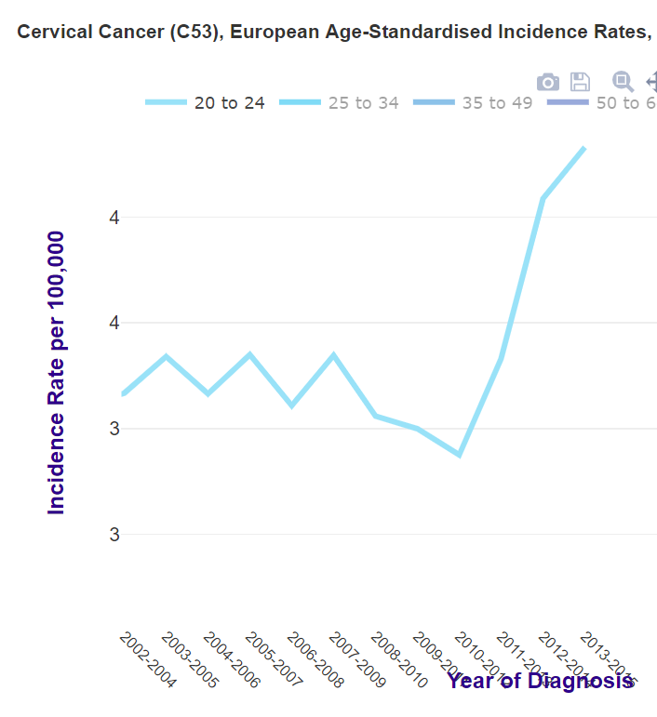
Increase of Incidence in the 20-24 age group
Based on a graphic created by Cancer Research UK.
In this group with 80% vaccine coverage
48% increase since 2010

Slide 28
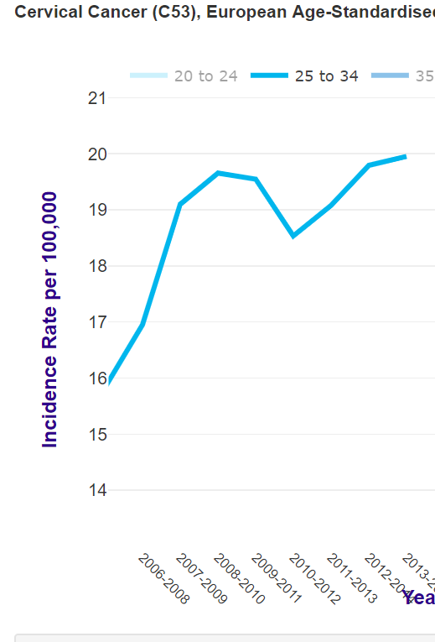
UK : trends 2007-2014 for 25-34
Based on a graphic created by Cancer Research UK.
20
18% increase for 25-34 (38% catch up vaccinated)
17

Slide 29
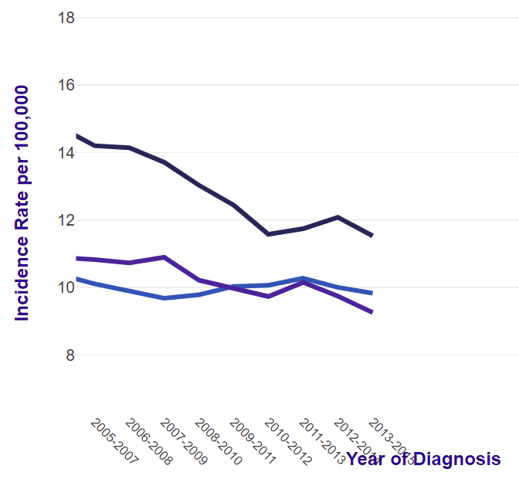
Incidence trends for unvaccinated women
During the vaccine period incidence decreased in unvaccinated age groups

Slide 30
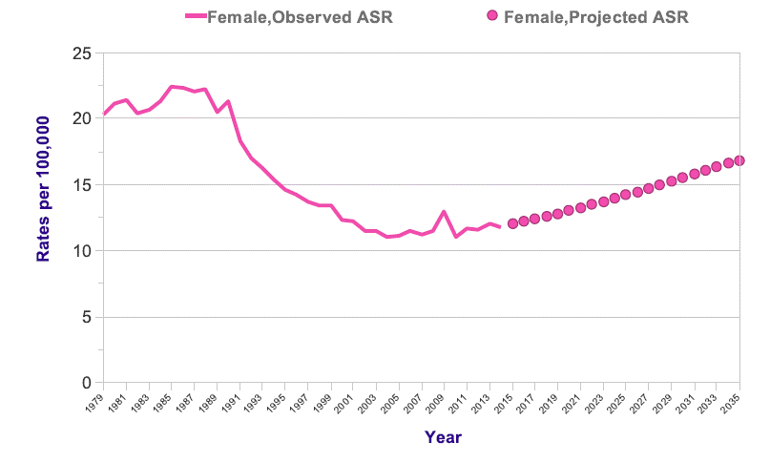
alarming official prediction
Vaccination

Slide 31
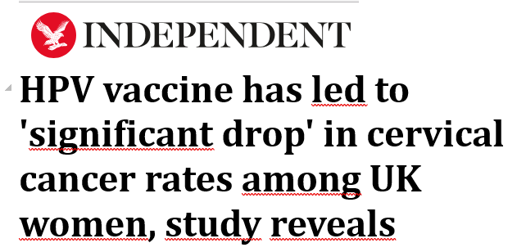
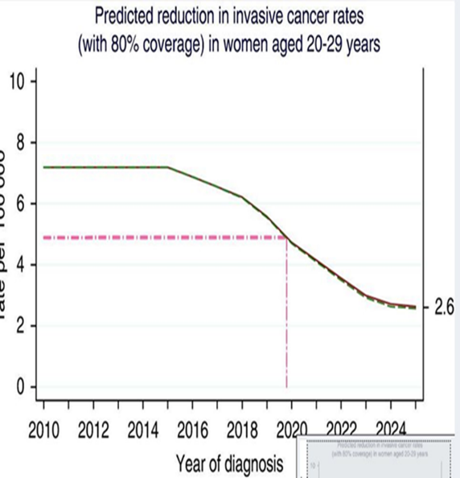
Fake news and lies..

Slide 32
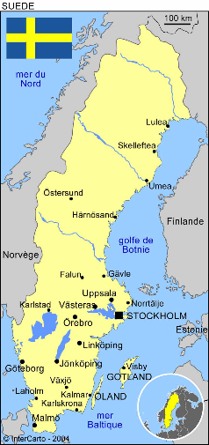
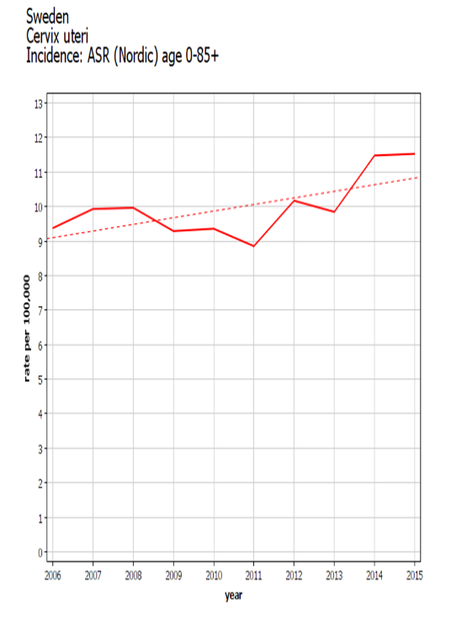
Sweden :global incidence trend
2006 Opportunistic vaccinations
2010 School vaccination campaign for 11-12 + catch up vaccination for 13-18
8,88
7,33

Slide 33
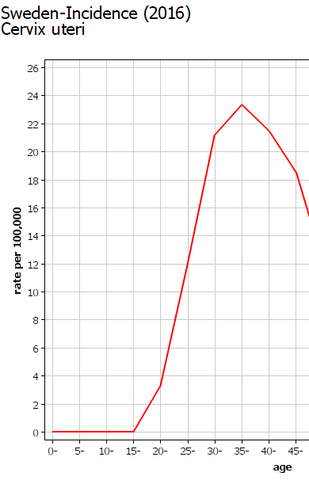
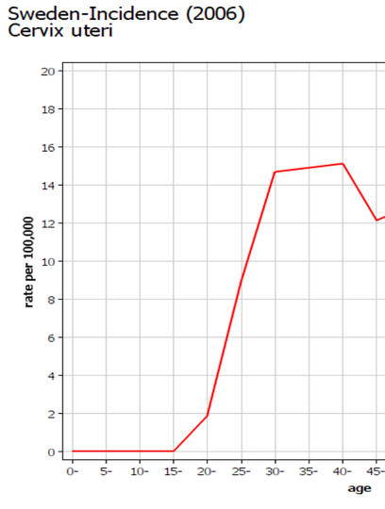
Sweden trends/age
Vaccination followed by a huge increase of invasive cancer
10 years after vaccination
Before vaccination

Slide 34
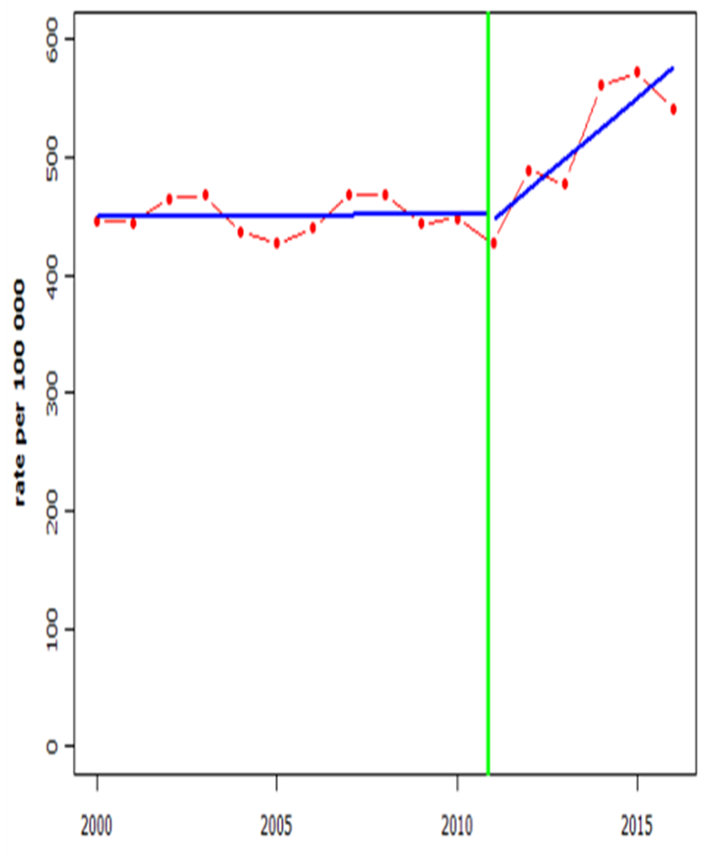
BREAK POINTS ANALYSIS
break-even point (BEP) is, the point at which a significant change in incidence trends appears
That permit to establish a eventual time correlation between vaccine and incidence increasing
In Sweden break point appears two years after school vaccination campaign

Slide 35
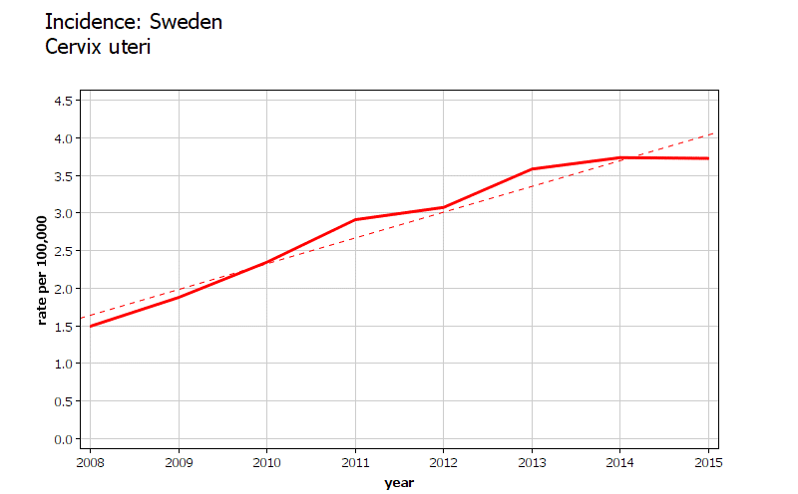
Incidence trend for 20-24 girls
Girls 14-18 during 2010 vaccination campaign were catch up vaccinated (80% vaccine coverage)
Their three years smoothed incidence increased by 150%
This increase is highly significant (P<0,001) and cannot be due to hazard
3,73
1,49

Slide 36
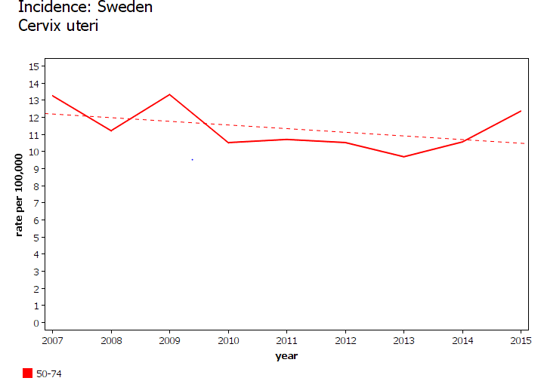
Unvaccinated women age group 50-74
13,24
12,34
Incidence decrease : 6%

Slide 37
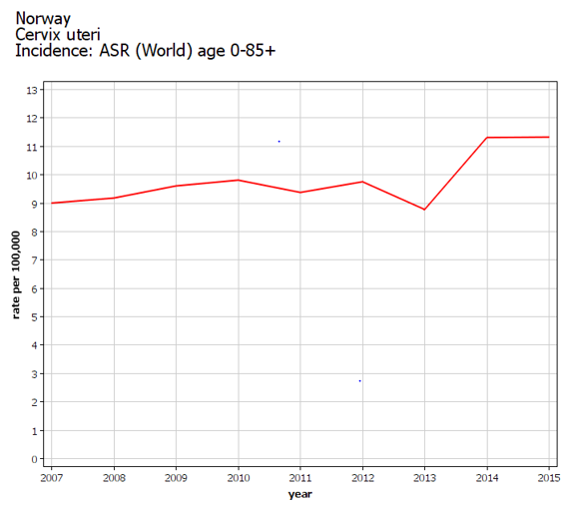
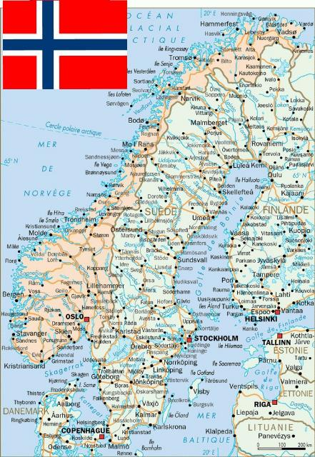
Global trend in Norway
11,33
8,99
Since vaccine global incidence increased by 25%

Slide 38
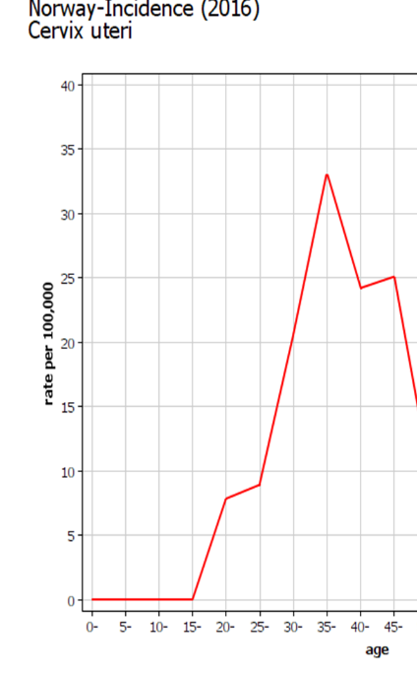
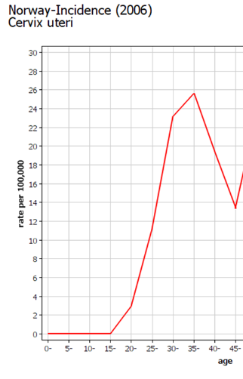
Norway incidence by age
10 years after vaccination
Before vaccination
Graphiques publiés par NORDCAN

Slide 39
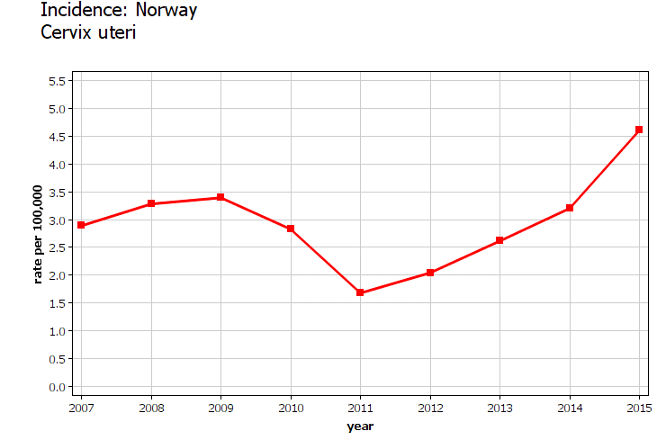
Incidence trends for 20-24
Three years smoothed incidence increased in Women 20-24
were 12-16 during the vaccination Campaign
(HPV coverage >80%)
This increase is statistically significant ( p<0,001)

Slide 40
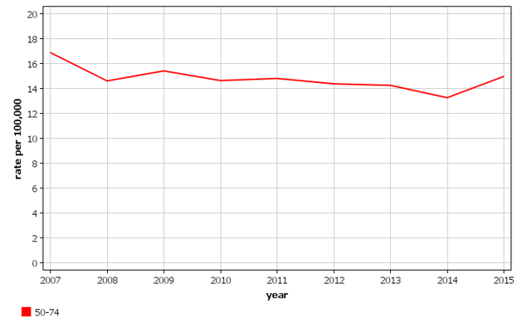
Norway : older women
16,85
14,94
11% decrease for 50-74

Slide 41
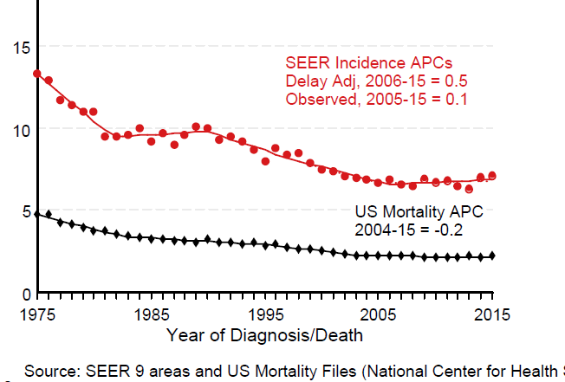
USA: incidence of invasive cancer 1975 - 2015
14
Since vaccin no more decrease in young women
6,6
With pap smear decrease 50 %
The American Cancer Society's estimates for 2019 : about 13,170 new cases and 4,250 deaths from cervical cancer.

Slide 42
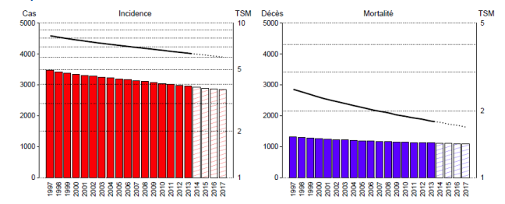
France: incidence and mortality 1997-2017
6
1,7
France with low gardasil coverage
benefited of permanent decrease in incidence and mortality

Slide 43
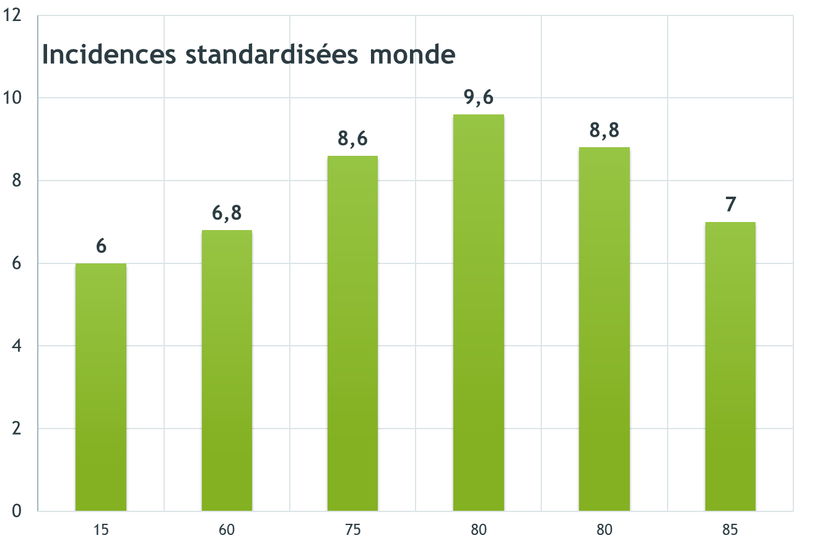
Last published incidence of cervix cancer and vaccination coverage
GB
Countries with high rate of vaccination coverage: higher incidence of invasive cervix cancer (mean value 10) than France (6)
Sweden
Norway
USA
Australia
France
% vaccine coverage

Slide 44
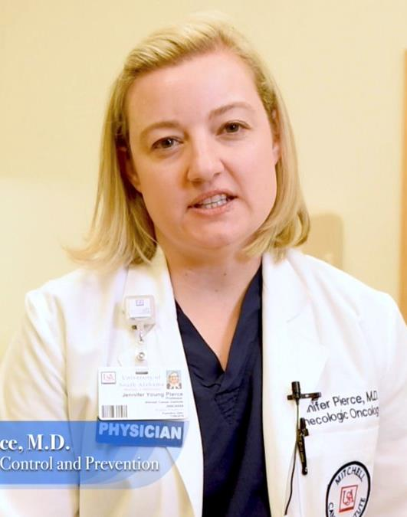
“the higher the rate of cancer in the county, the higher the rate of vaccination”
She should have rather observed: the higher the rate of vaccination in the county, the higher the rate of cancer !
Dr Pierce, strong avocate of HPV vaccine at the Society of Gynecologic Oncology’s 50th Annual Meeting on Women’s Cancer 2019 03

Slide 45
Conclusions ( 8/9 years of follow-up)
No decrease of invasive cervix cancer has been observed in high vaccination coverage groups contrary to the vaccine goals
For girls vaccinated when under12, the crude figures show an impressive (but non significant) incidence increase.
Nevertheless, similar trends in all the studied countries constitute a strong alarm signal.
For older girls, “catch up” vaccinated when over 13, a significant increase of invasive cancer incidence is registered.
This paradoxical oncologic result confirms the risk of this vaccination for non naïve girls observed initially in the pivotal study

Slide 46
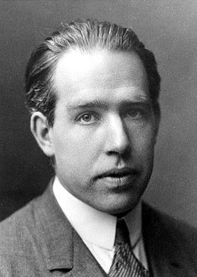
Why such a paradoxical oncologic result ?
Niels Bohr Nobel Price
How wonderful that we have met with a paradox.
Now we have some hope of making progress

Slide 47
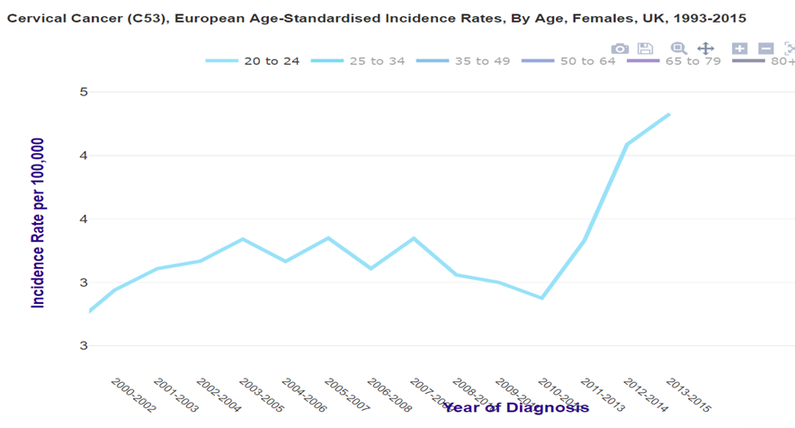
In U.K the temporality criteria is present
Graph of triennial smoothed incidence obtained from Cancer research U K
In U.K the increase appeared in the vaccinated groups after the vaccination campaign

Slide 48
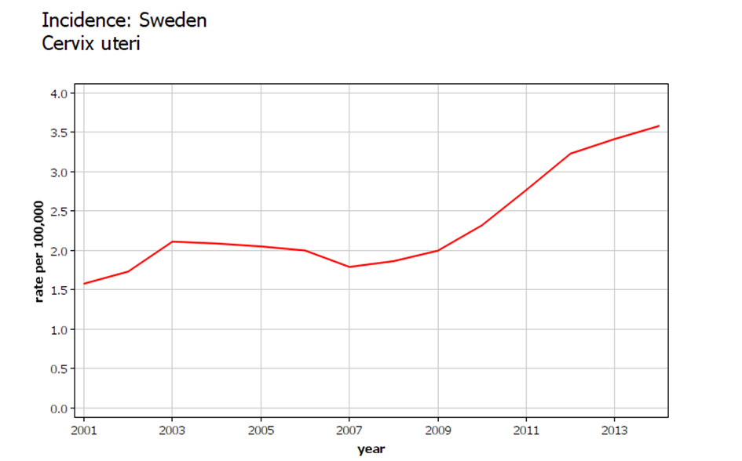
In Sweden the temporality criteria is present
Graph of triennial smoothed incidence for 20-24 (from Nordcan)
In the 20-24 age group the increase appeared after vaccine start (2009)

Slide 49
Some hypotheses to explain this paradoxical oncologic result
The modification of sexual practices is frequently advocated by vaccine propagandists
But why would the cancer increase appear just some years after vaccination campaign ?
when all studies on sexual practices show that changes are relatively minor and slow
and probably in the other direction: decrease in the frequency of sexual intercourse in UK
And why French girls whose practices do not seem different benefit of incidence decreasing ?

Slide 50
Some hypotheses to explain this paradoxical oncologic result
The risk of some women abandoning smear screening due to the misleading propaganda that vaccination protects against cervical cancer was highlighted by Diane Harper
“If more vaccinated young girls become women who voluntarily refuse cervical cancer screening, the rates of cervical cancer will increase.”
This has been observed in Australia but not in Great Britain nor Sweden.
Diane Harper Cervical cancer incidence can increase despite HPV vaccination www.thelancet.com/infection Vol 10 September 2010
Alison C Budd, Julia ML Brotherton, Dorota M Gertig, Theresa Chau, Kelly T Drennan and Marion Saville Cervical Screening for Women with Human Papillomavirus Med J Aust 2014; 201 (5) 279-282

Slide 51
The « type replacement”
The eradication of the few strains of the vaccine promotes the emergence of competing strains, potentially more aggressive
The efficacy of vaccine limited to 4 or 9 strains of HPV among 150 knowns, creates a true "ecological niche” , favourable to the proliferation of other possibly more dangerous strains
Eliminating strains targeted by the vaccine allows other strains to multiply, some of which can be more dangerous than those they replace
Fangjian Guo Fangjian Guo, Jacqueline M. Hirth, Abbey B. Berenson. Comparison of HPV prevalence between HPV-vaccinated and non-vaccinated young adults (20-26 years) Abstract n° 844 ASCO 2015 meeting Philadelphia

Slide 52
The increase in the risk of invasive cancers in women previously infected with the HPV virus
the initial review of the dossier provided by the laboratory to obtain the Market Authorization justified the FDA's recommendation to vaccinate prior to first intercourse
But this recommendation was neglected to expand the market and many vaccinations (so-called catch-up) were carried out in sexually active women
FDA Gardasil Clinical Review 2006 [cited 2018 Mar 22]. http://www.impfkritik.de/download/gardasil_fda_464_pages.pdf (pp.359-360)

Slide 53
IF THE VACCINE FACILITATES CANCER DIRECTLY ?
The very early onset of increased incidence after vaccination campaigns
as early as the second or fourth year after vaccination suggests a direct accelerating action of the vaccine
which may behave as a facilitator of cervical cancer, whose natural evolution requires 10 to 20 years rather.
The credibility of a direct facilitator effect of the vaccine on cervical cancer is strengthened by analogy with anti hepatitis B vaccination

Slide 54
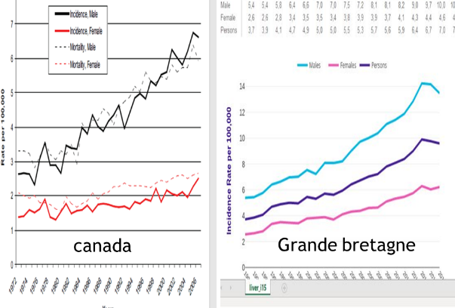
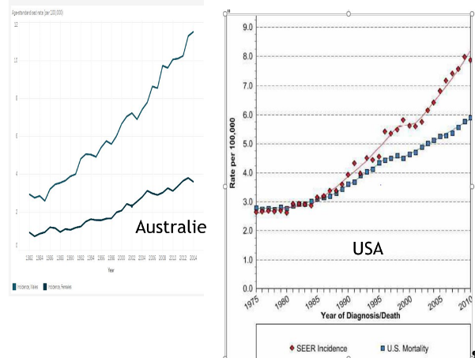
Facilitator action of vaccine is plausible as for hepatitis B vaccination was followed by a huge increase in the incidence of liver cancers

Slide 55
Conclusions: Gardasil vaccine
Experimental vaccin :
no proof of efficacy
indices of increasing risk
Heavy side effects
Useless (pap test)
Too risky bet
Too high price, high corruption

Slide 56
What can do women suffering of cervix cancer after vaccine ?
Sue lab and CDC for misinformation
for recommanding vaccin to prevent cancer
when it really increases the risk

Slide 57
What can you do ?
Meet your representatives
Show them the figures of cancer registers
Ask them to precise what they plan :
-to fight corruption in health services
-to obtain transparency in expertise and health agencies

Slide 58
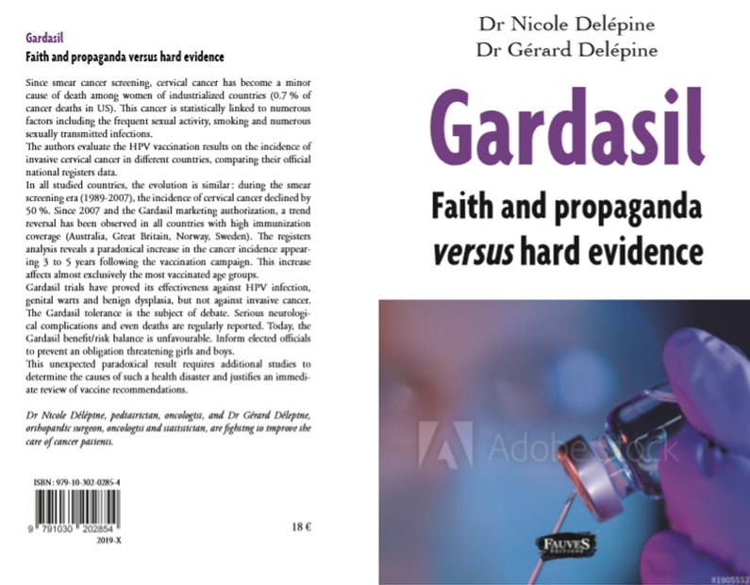
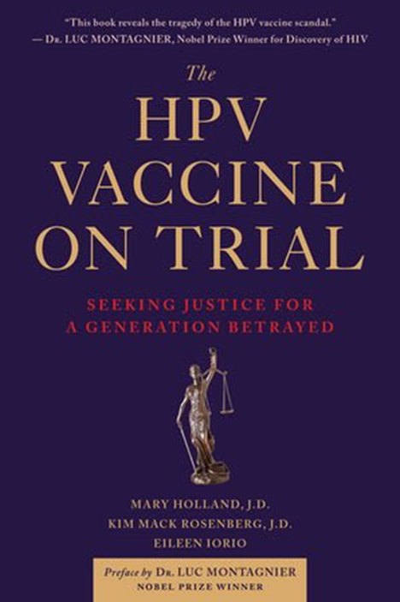
For more information!

